Slide 1
Objectives
In this session, you will learn to:
  Perform diagnostics by using tracing
  Configure service diagnostics
  Monitor services using Windows Azure diagnostics
Notes:
20487B
10: Monitoring and Diagnostics

Slide 2
Lesson 1: Performing Diagnostics by Using Tracing
Overview of .NET Diagnostics Tracing
Writing Trace Messages with System.Diagnostics.Trace
Writing Trace Messages with System.Diagnostics.TraceSource
Configuring Trace Listeners
Notes:
Make sure students understand that tracing is one of their responsibilities as developers. Code that does not use logging and auditing is difficult to manage and use.
20487B
10: Monitoring and Diagnostics

Slide 3
Overview of .NET Diagnostics Tracing
Tracing is required for diagnostics and performance measurements in production
Without tracing, it is difficult to verify if an application is working normally
Use System.Diagnostics.Trace to emit trace messages during run time
You can attach multiple trace listeners to store the information in a number of destinations
The trace listeners infrastructure is extensible
Notes:
Make sure students understand that tracing is one of their responsibilities as developers. Code that does not use logging and auditing will be difficult to manage and use.
20487B
10: Monitoring and Diagnostics

Slide 4
Writing Trace Messages with System.Diagnostics.Trace
The System.Diagnostics.Trace class provides methods for emitting trace messages:
  Write
  Assert
  Fail
  TraceError, TraceWarning, TraceInformation
  Flush
Categories can be provided to filter messages by trace listeners
Notes:
Explain the role of the trace class as the entry point for tracing code, and the separation from the actual writing, which is performed by Trace listeners.
20487B
10: Monitoring and Diagnostics

Slide 5
Writing Trace Messages with System.Diagnostics.TraceSource
The TraceSource class is used to write tracing messages and implement a tracing policy
  Sources are identified by name
Trace policies can be configured in the application configuration file
  SourceSwitch is attached to a TraceSource and defines what to trace
  A collection of TraceListener objects is attached to a TraceSource and defines how to trace
Notes:
The TraceSource class is recommended for tracing because it affords more configuration opportunities at run time to turn trace sources on and off and to configure trace levels.
20487B
10: Monitoring and Diagnostics

Slide 6
Configuring Trace Listeners
Trace listeners handle trace messages
  Persistence
  Routing
  Presentation
They can be associated with filters, providing another layer of filtering at the listener level
Notes:
Explain the role of the trace listeners, which perform the actual writing of messages as well as filtering.
Question
Why should you use the TraceSource class and not the Trace class?
Answer
You can use the TraceSource class to declare a number of trace sources in your application’s configuration file. Each trace source can be used in different parts of your application’s code. For each trace source, you can configure different listeners, switches, and filters. As a result, you gain more flexibility in your application’s instrumentation, and can easily tune trace sources in or out as operational needs dictate.
20487B
10: Monitoring and Diagnostics

Slide 7
Lesson 2: Configuring Service Diagnostics
Tracing with ASP.NET Web API
Recording WCF Diagnostic Information
Monitoring Services with Performance Counters
Demonstration: Tracing WCF Services
Troubleshooting IIS by Using Logs and Performance Counters
Notes:
This lesson describes how to enable tracing for different types of web services. The lesson discusses ASP.NET Web API and WCF tracing and then presents useful performance counters defined by web services frameworks and hosting environments.
20487B
10: Monitoring and Diagnostics

Slide 8
Tracing with ASP.NET Web API
To implement tracing in ASP.NET Web API, create a trace writer
Trace writers implement the ITraceWriter interface
ASP.NET Web API uses the trace writer to write a message before and after every stage in the messaging pipeline
Get the trace writers with the GetTraceWriter method from anywhere in the code to write your own trace messages
Notes:
Make sure students understand that ASP.NET Web API will use the implementation of the ITraceWriter interface to log operations during the messaging pipeline, but they can extend this tracing infrastructure with their own code.
20487B
10: Monitoring and Diagnostics

Slide 9
Creating a Trace Writer
public class MyTraceImplementation : ITraceWriter
{
public void Trace(HttpRequestMessage request, string category,
TraceLevel level, Action<TraceRecord> traceAction)
{
TraceRecord rec = new TraceRecord(request, category, level);
traceAction(rec);
PersistTrace(rec);
}
protected void PersistTrace(TraceRecord record)
{
var message = string.Format("The message is: {0};{1};{2}",
record.Operator, record.Operation, record.Message);
System.Diagnostics.Trace.WriteLine(message, rec.Category);
}
}
Notes:
Use the code sample to explain how to implement a trace writer. Emphasize there is no requirement to use System.Diagnostics.Trace to persist trace messages, and that you they can use any logging mechanism or framework to persist the message.
20487B
10: Monitoring and Diagnostics

Slide 10
Recording WCF Diagnostic Information
WCF tracing provides internal information that is useful for diagnosing problems and tuning performance
WCF message logging monitors communication on the wire
Turn tracing and message logging on with the WCF Service Configuration Editor
Use SvcTraceViewer.exe to open the tracing and message logging reports
Notes:
Make sure students understand that SvcTraceViewer.exe and WCF Services Configuration Editor do not need to be installed separately, as they already come packaged with Visual Studio 2012.
20487B
10: Monitoring and Diagnostics

Slide 11
Monitoring Services with Performance Counters
WCF and ASP.NET define a wide range of performance counters
Performance counters record various aspects of the service’s behavior
  Average request execution time
  Number of running service instances
  Number and rate of errors
Web load tests and other tools can sample and present the output of performance counters
Notes:
Tell the students that they should define their own performance counters exactly like WCF did. Custom performance counters together with WCF (or other infrastructure) performance counters will provide the whole picture for monitoring your application’s behavior.
Question
How can you combine WCF tracing information with performance counters to diagnose errors?
Answer
Performance counters can give you a general idea of where to look for errors, whereas WCF tracing information and message logs provide more details about specific errors.
You can start by inspecting performance counters to identify which WCF services are experiencing errors, and whether the problem is performance-related or involves exceptions at some point in the messaging pipeline. After you know where to look, you can enable WCF tracing and message logging to obtain more information about the problematic messages or service operations.
20487B
10: Monitoring and Diagnostics

Slide 12
Demonstration: Tracing WCF Services
In this demonstration, you will see how to obtain trace information from WCF services
Notes:
This demonstration illustrates how to obtain tracing information and message logs from a WCF service. Explain that errors in a production environment often require going over a large number of traces and message logs.
Preparation Steps
For this demo, you will use the available virtual machine environment. Before you begin this demo, you must complete the following steps:
On the host computer, click Start, point to Administrative Tools, and then click Hyper-V Manager.
In Hyper-V Manager, click MSL-TMG1, and in the Action pane, click Start.
In Hyper-V Manager, click 20487B-SEA-DEV-A, and in the Action pane, click Start.
In the Action pane, click Connect. Wait until the virtual machine starts.
Sign in using the following credentials:
User name: Administrator
Password: Pa$$w0rd
Demonstration Steps
On the Start screen, click the Visual Studio 2012 tile.
On the File menu, point to Open, and then click Project/Solution.
Browse to D:\Allfiles\Mod10\DemoFiles\TracingWCFServices\CalcService.
Select the file CalcService.sln, and then click Open.
In Solution Explorer, under the CalcService project, right-click Web.config, and then click Edit WCF Configuration.
In the Configuration pane, click Diagnostics.
Click Enable Tracing.
20487B
10: Monitoring and Diagnostics
(More notes on the next slide)

Slide 13
Notes:
Click Enable MessageLogging.
In the Configuration pane, expand the Diagnostics node, and then click the Message Logging node
In the right side pane, locate the LogEntireMessage property in the property grid. If it is set to False, set it to True.
On the File menu, click Save.
On the File menu, click Exit.
Return to Visual Studio 2012 and in Solution Explorer, under the CalcService project, right-click SimpleCalculator.svc and then click Set As Start Page.
Press Ctrl+F5. The WCF Test Client window will open.
Double-click the Div node in the pane to the left.
Set the a property to 4 and the b property to 2, and click Invoke. If a Security Warning dialog box appears, click OK.
Change the b property to 0, and click Invoke. If a Security Warning dialog box appears, click OK. A dialog box with an exception will be shown.
Click Close and then close the WCF Test Client window.
On the Start screen, click the Computer tile, and browse to D:\Allfiles\Mod10\DemoFiles\TracingWCFServices\CalcService\CalcService.
Double-click web_tracelog.svclog. This will open the Microsoft Service Trace Viewer application.
On the File menu, click Add.
In the Open dialog box, browse to D:\Allfiles\Mod10\DemoFiles\TracingWCFServices\CalcService\CalcService, click
(More notes on the next slide)
20487B
10: Monitoring and Diagnostics

Slide 14
Notes:
web_messages.svclog, and then click Open.
Click the Activity tab to view the trace logs.
Click the line in red that says Process action http://tempuri.org/ICalc/Div.
On the pane to the right, click the red line that starts with Handling an exception.
On the Formatted tab, show the Exception Information group.
On the pane to the right, click the line that says Message Log Trace.
Click the Message tab.
Show the message content.
Close the Microsoft Service Trace Viewer window.
Question
When should you use WCF message logging in addition to tracing?
Answer
Message logging provides message headers and bodies for every request and response delivered to your service. The higher level of details helps diagnose difficult problems more easily. You can use this additional information to determine whether a message was malformed, a parameter was incorrect, or a message header was unexpected or missing.
(More notes on the next slide)
20487B
10: Monitoring and Diagnostics

Slide 15
Troubleshooting IIS by Using Logs and Performance Counters
IIS provides two types of logging mechanisms
  Log file – log information about requests and responses (client IP, response status code, processing time…)
  Failed request tracing – log trace events from ASP.NET and IIS modules for specific types of requests
Use logs to look for client activity patterns and locate server errors
Use failed request tracing to identify the cause of errors during request processing
IIS provides additional performance counters to those of ASP.NET
Notes:
IIS logging and performance counters provide a clear view of the web server's behavior. Make sure students understand that in addition to the tools provided by IIS, they should also add logs and performance counters to their code, which handles the request.
20487B
10: Monitoring and Diagnostics

Slide 16
Lesson 3: Monitoring Services Using Windows Azure Diagnostics
Overview of Windows Azure Diagnostics
Types of Collectable Diagnostic Data
Configuring Diagnostics
Viewing Collected Diagnostics Data
Demonstration: Configuring Windows Azure Diagnostics
Logging Windows Azure Storage Requests
Using IntelliTrace in Windows Azure
Notes:
Question
When should you use each of the diagnostic mechanisms explained in this lesson?
Answer
You should use Windows Azure Storage Analytics to diagnose performance issues with your Windows Azure Storage services and to identify any failed requests from Windows Azure Storage. You should use Windows Azure Diagnostics to collect general information, such as log files and performance counters, from your Windows Azure Cloud Services. Finally, you should use IntelliTrace to collect detailed information on your application’s execution in Windows Azure, if all other sources of diagnostic information did not lead you to the cause of the problem.
20487B
10: Monitoring and Diagnostics

Slide 17
Overview of Windows Azure Diagnostics
With on-premises servers, you can collect the diagnostics information stored on their local disks
Windows Azure virtual machines are not persisted and storing log files on local disks is not recommended
Windows Azure Diagnostics:
  Collects diagnostic information from running web and worker roles and persists it to Windows Azure Storage
  Can collect all kinds of diagnostic information including:
    Windows event logs
    IIS logs
    Service application logs
Notes:
Make sure students understand that Windows Azure Diagnostics does not generate diagnostic data. It only aggregates data from different sources to a single location in Windows Azure Storage.
20487B
10: Monitoring and Diagnostics

Slide 18
Types of Collectable Diagnostic Data
Windows Azure Diagnostics can collect data from many sources:
  Performance counters
  .NET Tracing
  IIS logs and failed request tracing
  Windows Event Logs
  Windows Azure infrastructure logs
  Custom file-based logs
  Crash dumps
File-based data buffers are persisted in blobs
Other data is persisted in tables
Notes:
Explain that Windows Azure Diagnostics does not collect all the sources automatically. You need to specify which sources to collect, how often to collect them, and where to place them.
20487B
10: Monitoring and Diagnostics

Slide 19
Configuring Diagnostics
Windows Azure Diagnostics Configuration:
  What to collect
  How often to collect
  Where to persist
Configuration information is stored in blob storage
You can configure diagnostics by using:
  XML configuration file (diagnostics.wadcfg)
  Using the DiagnosticMonitorConfiguration class
  Remotely, by using the DeploymentDiagnosticManager class
Notes:
Explain that you can configure most diagnostics settings from Visual Studio 2012. Explain that by default, every role in a cloud project has diagnostics enabled.
20487B
10: Monitoring and Diagnostics

Slide 20
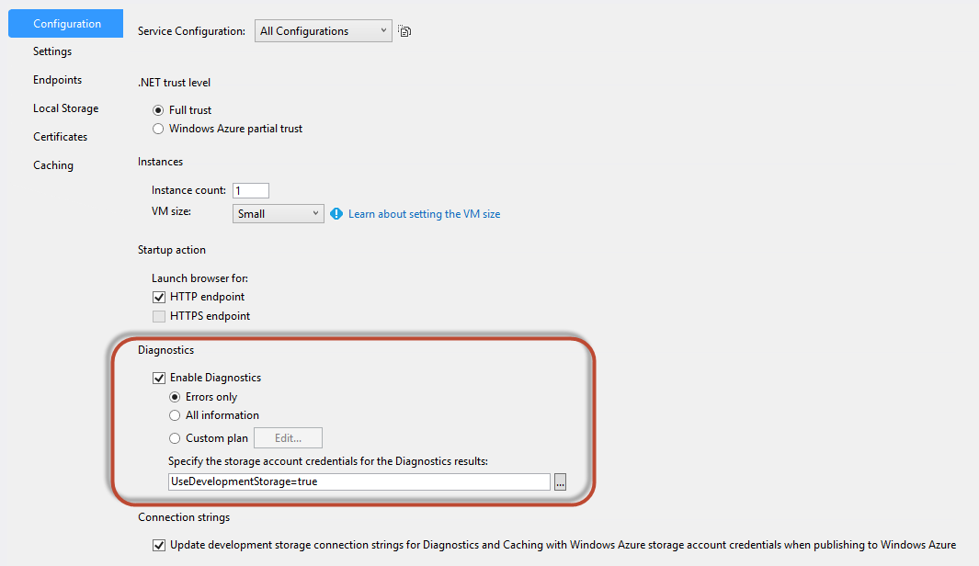
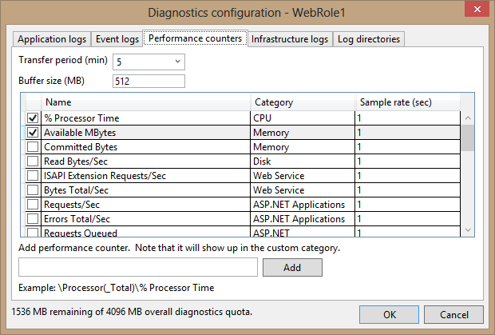
Configuring Diagnostics with Visual Studio 2012
Notes:
Explain the difference between the Errors only, All information, and Custom plan options. Explain briefly which source each tab in the Diagnostics configuration dialog box configures.
20487B
10: Monitoring and Diagnostics

Slide 21
The diagnostics.wadcfg File
<?xml version="1.0" encoding="utf-8"?>
<DiagnosticMonitorConfiguration
configurationChangePollInterval="PT1M" overallQuotaInMB="4096" >
<DiagnosticInfrastructureLogs />
<Directories>
<IISLogs container="wad-iis-logfiles" />
<CrashDumps container="wad-crash-dumps" />
</Directories>
<Logs bufferQuotaInMB="1024" scheduledTransferPeriod="PT1M"
scheduledTransferLogLevelFilter="Error" />
<WindowsEventLog bufferQuotaInMB="1024" scheduledTransferPeriod="PT1M"
scheduledTransferLogLevelFilter="Error">
<DataSource name="Application!*" />
</WindowsEventLog>
</DiagnosticMonitorConfiguration>
Notes:
Go over the XML configuration and explain the different parts of it. The elements under the <DiagnosticsMonitorConfiguration> root element specify the different sources to collect. Explain the meaning of the bufferQuotaInMB, container, and scheduledTransferPeriod attributes.
20487B
10: Monitoring and Diagnostics

Slide 22
Viewing Collected Diagnostics Data
To view the collected diagnostics information, read the data from the blob and table storage
  Download logs stored in blobs
  View event logs and other textual data stored in tables
  Retrieve raw performance counters data from tables, and plot graphs according to the data
Viewing tools available:
  System Center (SCOM)
  Visual Studio 2012
  Windows Azure Management Portal
  Third-party tools
Notes:
Emphasize that Visual Studio 2012 is not capable of showing graphs for performance counters, only their raw data. Explain it is important to find a useful tool that is capable of presenting all the diagnostic information you collect. Refer students to the manual content for a link to MSDN where several viewing and analysis tools, including third-party tools, are listed.
20487B
10: Monitoring and Diagnostics

Slide 23
Demonstration: Configuring Windows Azure Diagnostics
In this demonstration, you will see how to configure Windows Azure Diagnostics
Notes:
Explain that by using Visual Studio 2012 you can view the content of trace logs, Windows Event logs, and other collected files, such as IIS logs. Explain that Visual Studio 2012 is not the ideal tool to view collected performance counters, because it cannot display them as a bar graph.
Preparation Steps
For this demo, you will use the available virtual machine environment. Before you begin this demo, you must complete the following steps:
On the host computer, click Start, point to Administrative Tools, and then click Hyper-V Manager.
In Hyper-V Manager, click MSL-TMG1, and in the Action pane, click Start.
In Hyper-V Manager, click 20487B-SEA-DEV-A, and in the Action pane, click Start.
In the Action pane, click Connect. Wait until the virtual machine starts.
Sign in using the following credentials:
User name: Administrator
Password: Pa$$w0rd
Demonstration Steps
On the Start screen, click the Visual Studio 2012 tile.
On the File menu, point to Open, and then click Project/Solution.
Browse to D:\Allfiles\Mod10\DemoFiles\AzureDiagnostics\Begin\AzureDiagnostics.
Select the file AzureDiagnostics.sln, and then click Open.
In Solution Explorer, expand the AzureDiagnostics project, expand Roles, right-click the DiagnosticsWebRole role, and click Properties.
In the Properties window, on the Configuration tab, under Diagnostics, select the Custom plan option, and then click Edit.
In the Diagnostics configuration dialog box, on the Application logs tab, change the Log level
20487B
10: Monitoring and Diagnostics
(More notes on the next slide)

Slide 24
Notes:
from Error to Verbose.
Click the Log directories tab, and in the Transfer period combo box, select 1.
In the Buffer size box, type 1024.
In the Directories grid, in the IIS logs row, type 1024 in the Directory quota (MB) column.
Click OK, and then press Ctrl+S to save the changes to the role configuration.
In Solution Explorer, right-click the AzureDiagnostics project and click Set as StartUp Project.
Press Ctrl+F5 to run the project without debugging.
In Internet Explorer write a message in the Log Text box. Click Write to trace provider, which will write the text to the trace log.
Close the browser and return to Visual Studio 2012.
On the View menu, click Server Explorer.
In Server Explorer, expand Windows Azure Storage, and then expand (Development).
Right-click Tables, and then click Refresh.
Expand the Tables node, and double-click WADLogsTable. If you do not see the WADLogsTable, it might be that the logs have not been uploaded yet to the table storage. Wait one minute for the logs to upload, and then repeat step 18 to refresh the tables list.
Scroll right and explore the table by looking at the Message column which presents the value of the logged events.
Note: Log data will be transferred to the Windows Azure storage emulator once a minute. If you cannot see the Log data, please wait one minute before checking again.
In Server Explorer expand Windows Azure Storage, then expand Development, and then expand Blobs. Double-click wad-iis-logfiles.
Right-click the first line and then click Open. If you are asked to pick the application to open this file
(More notes on the next slide)
20487B
10: Monitoring and Diagnostics

Slide 25
Notes:
type, click More options and choose to open the file with Notepad.
Inspect the file and show its content.
Close Notepad.
Question
Why does Windows Azure require a special diagnostic solution?
Answer
Multiserver environments such as Windows Azure require special diagnostic solutions because the multiple machines all produce logs and traces at the same time, making it difficult to get an overall view.
While creating a consolidated view for a multiserver environment can be challenging, the cloud, with its elastic nature, poses an even bigger challenge. Since virtual machines can be provisioned or released at runtime, the data stored on the virtual machines can be lost. Virtual machines are not only released during this scaling down, but also when a service fails. Because of this volatility, data needs to be safely transferred to cloud storage when running in a cloud environment.
(More notes on the next slide)
20487B
10: Monitoring and Diagnostics

Slide 26
Logging Windows Azure Storage Requests
You can monitor the behavior of Windows Azure Storage by enabling storage analytics
Storage analytics provide information about storage requests for blobs, tables, and queues
Enable storage analytics through the Windows Azure Management Portal
Logs are persisted to the $Logs blob container
Notes:
Explain that Windows Azure Storage can be monitored. It should not be treated as a black box. The details about the type and structure of the data that is created by Storage Analytics is not covered in this topic, so encourage students to look at the MSDN documentation for more details.
20487B
10: Monitoring and Diagnostics

Slide 27
Using IntelliTrace in Windows Azure
IntelliTrace simplifies debugging by collecting execution information on the fly
Method calls, local variables, and execution events are available across the execution time line
You can open IntelliTrace log files by using Visual Studio 2012 and then see the execution flow
You can enable IntelliTrace on Windows Azure by creating a dedicated deployment
You can download IntelliTrace from the cloud service by using Visual Studio 2012
Notes:
Emphasize that using IntelliTrace on the server should be your last debugging option. First, try to debug your application locally by using the Compute Emulator and basic Visual Studio debugging features. Consider using IntelliTrace Only only if you cannot reproduce the issue locally, consider using IntelliTrace.
Remind students that IntelliTrace should not run in production. It has a high performance cost.
20487B
10: Monitoring and Diagnostics

Slide 28
Summary
In this session, you have learned that:
  Tracing is required for diagnostics and performance measurements in production
  Use System.Diagnostics.Trace to emit trace messages during run time
  WCF tracing provides internal information that is useful for diagnosing problems and tuning performance
  WCF message logging monitors communication on the wire
  Storage analytics provide information about storage requests for blobs, tables, and queues
  IntelliTrace simplifies debugging by collecting execution information on the fly
Notes:
20487B
10: Monitoring and Diagnostics

Slide 29
What’s Next?
The next session covers Lab@Home. In this session, you need to perform Exercise 1 and Exercise 2 of Module 8.
Ensure to take the required input files from the faculty for performing these exercises.
Notes:
20487B
2: Querying and Manipulating Data Using Entity Framework

